Slide 1
Work Zone Speed Zones
Dave Holstein/Reynaldo Stargell
Office of Traffic Engineering

Slide 2
Talking Points for this Presentation
Current TEM Part 6 Work Zone Speed Limit Reduction Process
2010 Work Zone Speed Zone Pilot
Research Summary and Basic Approach
Proposed Work Zone Speed Zone Process
Example – Result for a Rural Night Time Paving Calculation
Items to be Addressed in the Future
Notes:
Basic outline of the presentation and an explanation of acronyms used. The acronyms don’t need explained so much as long as the presenter understands them…it is here more for any possible printing that might occur of this presentation.

Slide 3
Why are we changing??
There has been some “question” whether the current process in TEM part 6 meets law (regarding a Study & Documentation)
Does not address short-term situations such as nighttime work, usually involving drums, and force account work.

Slide 4
Current TEM Part 6 Work Zone Speed Limit Reduction Process
10 mph reduction shall be implemented in projects on freeways and expressways and on rural four or more lane highways meeting the following:
30 consecutive calendar days, AND ½ mile in length
However, doesn’t apply to:
Bridge rehabilitation/repair work; Night only closures; Projects of less than one-half mile in length; Cleanup work and other work beyond the shoulder, after restoration of all full-width lanes and shoulders to traffic
BTW – this process is still in effect
Notes:
(Wrote out more on the slide than you actually need to say…more complete for printed copies or people referring to this later.)
When we say the “Old Process” we mean the currently publish TEM process. We are just referring to it as old because it will be replaced as soon as we can – will discuss this more later.
Most of us are familiar with the old process so I don’t need to go into too much detail here. This process applied a 10 mph reduction to projects on freeways, expressways and rural four or more lane highways that were 30 or more days, 0.5 mile or more in length, with restricted or reduced roadway widths or pavement conditions. The approaches to the zone still needed to be designed to the original posted speed limit but the MOT items within the zone were permitted to be designed to the reduced speed limit.
Reductions via this process were not intended to be used in spot locations like bridge rehabilitation, in locations where all lanes have been restored and have full-width lanes and shoulders, and where there are night only closures. More recently we wanted to create a process where some of these situations could be addressed with appropriate speed limit reductions. The 2010 pilot was a trial for opening the process to include zones similar to the night only closures (althought it didn’t only have to occur at night) and the spot locations.

Slide 5
2010 Work Zone Speed Zone Pilot
Last Fall we were advised that we are allowed to provide a short-term variable speed limit, and established a Pilot to provide such Speed Zones.
Pilot Evaluation – The pilot was used to:
complete a trial run of the Freeway Work Zone Speed Evaluation Sheet.
test a process for implementing work zone speed zones on “short-term” projects.
vet out some of the issues that might arise with revamping the work zone speed limit process.
Notes:
Our first step was to launch a pilot to complete a trial run of the evaluation sheet, first expand speed limit revisions in work zones in which were not necessarily stationary in an environment in which we could retract if unanticipated problems arose and in an attempt to vet out some of the issues that would likely arise when rewriting the work zone speed limit process.
The pilot was issued on August 31, 2010. It was launched for a narrow set of projects - primarily for what we defined as “transitory” work zones with drums or cones on high-speed (55 mph or greater) multi-lane highways where workers were located in a closed lane or shoulder area adjacent to traffic and were not protected by PCB.

Slide 6
2010 Work Zone Speed Zone Pilot
The Pilot was –
Applied to both contract and ODOT force account work;
Applied to both existing and new projects starting before December 1, 2010; and
If an around-the-clock reduction was already in place on a project per TEM Part 6, the pilot process would not apply.
Notes:
The pilot process was available for both contract and ODOT force account work and applied to both existing and new projects starting before December 1, 2010 (the ending date of the pilot).
In addition, if a speed limit reduction was already in place per the existing TEM (or “old” process) then the pilot would not apply. The thought here was that if the speed limit was already reduced we wouldn’t want to necessarily double-reduce it. Also there was some concern about keeping multiple speed limits straight for a pilot in the event that a transitory type operation further reduced the speed for a length that was not equal to the reduction put in place by the current TEM. So for purposes of the pilot and until we were able to further refine the process and forms we just did not include those in the pilot.

Slide 7
Research Summary and Basic Approach
OTE and the Speed Zoning Working Group completed an informal literature search looking for past research completed on the subject.
Many documents were found, but two notable reports were:
NCHRP Project 3-41 “Procedure for Determining Work Zone Speed Limit” (March 1993) Final Report, and
NCHRP Project 3-41(2) “Effectiveness and Implementability of Procedures for Setting Work Zone Speed Limit” Final Report (May 1998)
Notes:
Based on some of the questions raised, we went on a search to see what research had been completed on the subject.
We found a lot of documents, but two reports which have had an impact on the new proposed process are shown here. These reports are dated but interestingly enough it almost felt like they could have been written in the recent years. They were posing a lot of the same questions that we are still asking today.
The first report created a work zone speed limit procedure and the second one validated the procedure.

Slide 8
Research Summary and Basic Approach
The study findings indicate the following:
“Work zone speed limit reductions should be avoided, whenever possible.”
“Work zone speed limit reductions larger than 10 mph are undesirable and should be avoided, except where required by restricted geometrics or other work zone features that cannot be modified.”
Speed variance is more exaggerated with reductions of more than 10mph.
Notes:
Here are a few of the study findings…
Reductions should be avoided, whenever possible. This is also supported by the current OMUTCD and 2009 MUTCD which state “Reduced speed zoning (lowering the regulatory speed limit) should be avoided as much as practical because drivers will reduce their speeds only if they clearly perceive a need to do so.”
Reducing more than 10 mph is undesirable and should be avoided except where required by restricted geometrics or other work zone features that cannot be modified. The current OMUTCD supports this as well “A reduction of more than 10 mph in the speed limit should be used only when required by
restrictive features in the TTC zone. Where restrictive features justify a speed reduction of more than 10 mph, additional driver notification should be provided.” Additionally, under Support notes “Research has demonstrated that large reductions in the speed limit, such as a 30 mph reduction, increase speed variance and the potential for crashes. Smaller reductions in the speed limit of up to 10 mph cause smaller changes in speed variance and lessen the potential for increased crashes. A reduction in the regulatory speed limit of only up to 10 mph from the normal speed limit has been shown to be more effective.”
When they compared compliance they found that compliance was generally higher within the work zone than upstream of the work zone when no reduction was in place. Furthermore, compliance was generally lower within the work zone than upstream of the work zone when the speed was reduced 10 mph. Reductions of more than 10 mph further decreased compliance. LESSON HERE IS THAT IF YOUR GOAL IS TO MAXIMIZE COMPLIANCE, DO NOT LOWER THE SPEED LIMIT.
They used speed variance to be a surrogate measure of safety based on the premise that accident potential is increased by the size and frequency of speed differences between adjacent vehicles. When they compared variance in the speeds upstream of the work zone to variances in the speeds within the work zone they found an increase of 16% in the variance when no reduction was in place compared to an increase of 10% when a 10 mph reduction was in place. These results were in the validation report, which only looked at 0 and 10 mph reductions because this is what their process calls for. The prior report (the one that created the procedure) looked at a wider range of speed reduction amounts, they had similar results (no reduction had 61% higher variances, 10 mph had 34% higher variances and reductions of 15 mph or more had higher variances ranging from 81-93%). LESSON HERE IS THAT IF YOU ARE GOING TO REDUCE THE SPEED LIMIT, 10 MPH IS LIKELY TO MINIMIZE SPEED VARIANCE INCREASES IN TRAFFIC WITHIN THE WORK ZONE.
Taking all of this was taken into consideration when developing the newly proposed work zone speed zone process. It should be noted, though, that while we did base the proposed process on parts of the process outlined in the reports, we did not necessarily incorporate all of it or the items as exactly as shown in the report.
OMUTCD:
Reduced speed limits should be used only in the specific portion of the TTC zone where conditions or
restrictive features are present. However, frequent changes in the speed limit should be avoided. A TTC plan
should be designed so that vehicles can reasonably safely travel through the TTC zone with a speed limit
reduction of no more than 16 km/h (10 mph).
A reduction of more than 16 km/h (10 mph) in the speed limit should be used only when required by
restrictive features in the TTC zone. Where restrictive features justify a speed reduction of more than 16
km/h (10 mph), additional driver notification should be provided. The speed limit should be stepped down in
advance of the location requiring the lowest speed, and additional TTC warning devices should be used.
Reduced speed zoning (lowering the regulatory speed limit) should be avoided as much as practical
because drivers will reduce their speeds only if they clearly perceive a need to do so.
Support:
Research has demonstrated that large reductions in the speed limit, such as a 50 km/h (30 mph)
reduction, increase speed variance and the potential for crashes. Smaller reductions in the speed limit of up
to 16 km/h (10 mph) cause smaller changes in speed variance and lessen the potential for increased crashes.
A reduction in the regulatory speed limit of only up to 16 km/h (10 mph) from the normal speed limit has
been shown to be more effective.
Section 4511.21 of the Ohio Revised Code establishes how speed limits may be reduced and Part 6 of
the ODOT “Traffic Engineering Manual” (see Section 1A.11) provides additional information on speeds in
TTC zones.

Slide 9
Proposed Work Zone Speed Zone Process
Applies to freeways, expressways and other high-speed (55 mph or greater) multi-lane highways.
Normally applied during design, but can be applied during construction, and can be used for ODOT operations/maintenance work.
Flowcharts outlining the process for each will be included in the TEM upon publication of the proposed process.
Notes:
This proposed process will apply to all high-speed (existing 55 mph or greater) multi-lane highways. This is all that we currently feel can appropriately be addressed by the forms that have been developed at this point. As the existing speeds start out lower, we feel that the characteristics change enough that they shouldn’t be addressed using the same form. Additional facilities, along with varying forms to address them, may be developed in the future. In regards to two-lane highways we are not yet sure about the appropriateness of using speed limit reductions in those situations. (Should be slowing/stopping for a flagger, etc anyways).
The process is intended to be first applied during design but can be applied during construction and can be used for ODOT operations/maintenance work. Flowcharts for the process based on each of these three will be included in the TEM.

Slide 10
During Design
High-Speed Multi-Lane Highway
(55 mph or greater)?
NO
YES
This proposed process doesn’t apply – handle on a case by case basis in coordination with DWZTM and DSZC.
Designer references Table 1297-7.
Designer submits documentation to DSZC for review/approval.
Did Form 1297-17 warrant a reduced speed limit?
YES
Does Table 1297-7 suggest use of Form 1296-17 (Excel)?
YES
NO
NO
If approved, DSZC prepares Speed Limit Revision Form and returns a copy to the Designer and OTE. Designer incorporates speed limit reduction into plans.
Speed limit reduction is not warranted based on conditions identified at this time.

Slide 11
Basically, the Designer reviews Table 1297-7, which lists work activities and conditions that may “warrant” a possible speed reduction.
Below are two excerpts from the table

Slide 12
Proposed Work Zone Speed Zone Process: Form 1296-17 – Work Zone Speed Evaluation Sheet
IF Table 1297-7 indicates that a speed reduction may warranted based upon proposed work zone, use the Excel Speed Evaluation sheet is used to determine the numerical value of the reduction.
Designer plugs values into the spread sheet and it provides the “CALCULATED SPEED”.
District can “override” the calculated value based upon conditions not accounted for by the spread sheet. This value is the “RECOMMENDED SPEED”.
“RECOMMENDED SPEED” is what gets journalized and used in the project
Notes:
Here is a draft of Form 1296-17 which is the Work Zone Speed Evaluation Sheet. This is just to give you an idea…it is similar to the one that was used in the 2010 pilot, but some changes have been made to it since then. Some other minor modifications still need made to it.
This form has you input the existing legal speed limit, the number of access points per mile (includes on and off ramps and construction openings used by project vehicles), ADT per lane, shoulder width (narrowest side), lane width and if barrier is being used. Once all of those parameters are put in the form will provide you with a calculated speed. The form user does have the ability to recommend an additional reduction based on restrictive geometrics or other features that can not be modified and have not already been taken into consideration. Remember the information regarding compliance and variance – no reduction is best for compliance and if you are going to reduce, 10 mph had the smallest increase in variance. Any additional reductions should be the “exception” not the “rule”.

Slide 13
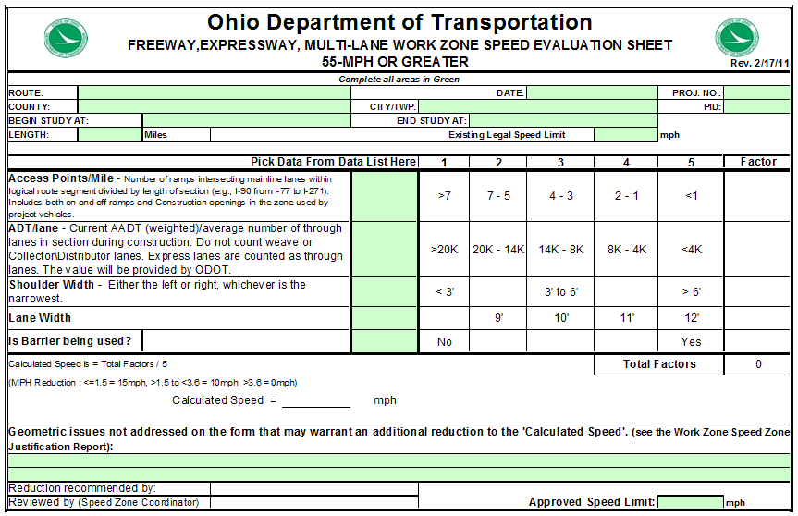
Proposed Work Zone Speed Zone Process: Form 1296-17 – Work Zone Speed Evaluation Sheet
DRAFT
Notes:
Here is a draft of Form 1296-17 which is the Work Zone Speed Evaluation Sheet. This is just to give you an idea…it is similar to the one that was used in the 2010 pilot, but some changes have been made to it since then. Some other minor modifications still need made to it.
This form has you input the existing legal speed limit, the number of access points per mile (includes on and off ramps and construction openings used by project vehicles), ADT per lane, shoulder width (narrowest side), lane width and if barrier is being used. Once all of those parameters are put in the form will provide you with a calculated speed. The form user does have the ability to recommend an additional reduction based on restrictive geometrics or other features that can not be modified and have not already been taken into consideration. Remember the information regarding compliance and variance – no reduction is best for compliance and if you are going to reduce, 10 mph had the smallest increase in variance. Any additional reductions should be the “exception” not the “rule”.

Slide 14
Proposed Work Zone Speed Zone Process: Form 1296-17 – Work Zone Speed Evaluation Sheet
Completed (by designer) 1296-17 Spread Sheet Is Submitted to the District Speed Zone Coordinator for Review and Approval.
Reduction is only in effect during actual hours conditions exist (ex – Night time Paving).
The Speed Zone Study and Documentaion of when the speed limit is in effect is critical to Legality.

Slide 15
After Plan Completion
At the time of the pre-construction meeting, the State Highway Patrol and local enforcement (if applicable), are notified of the work zone speed limit reduction.
The PE fills out the weekly tracking log and submits it to the DWZTM. (Weekly for short term projects and at phase changes for long-term projects.)
The DSZC processes the speed limit withdrawal paperwork. A copy is sent to OTE.
Upon finalization, notification is sent by the PE to the DWZTM and DSZC so that a withdrawal of the work zone speed limit reduction can be processed.
Work zone speed limit reduction
has been withdrawn. Process is complete.

Slide 16
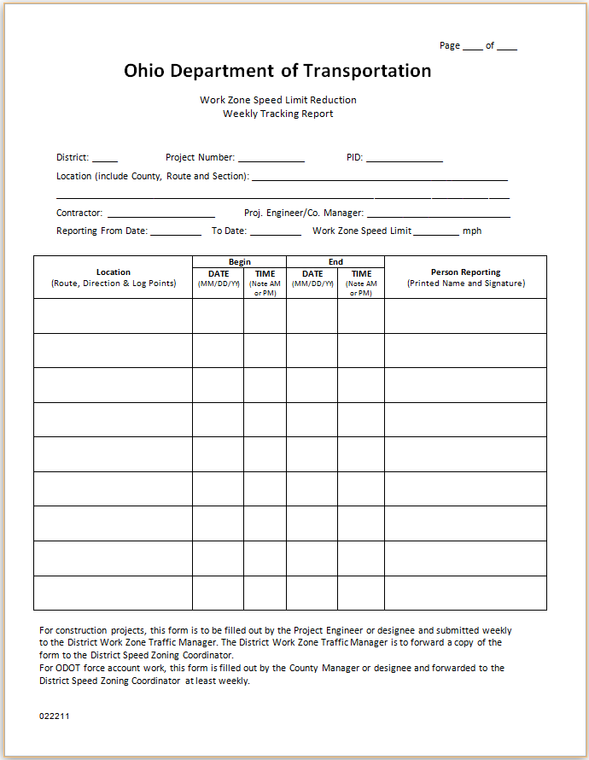
Proposed Work Zone Speed Zone Process: Form 1296-18 – Weekly Tracking Log/Report
CRITICAL piece of documentation
Regardless of the proposed change in the process this document fills one of the holes that we were told that was open under the existing process (legal-wise).
Documents
Location (Route, Direction & Log Points)
Date/Time Began
Date/Time Ended
Person Reporting
DRAFT
Notes:
Here is the draft Weekly Tracking Log/Report. This is virtually the same as the one used during the 2010 pilot.
As mentioned earlier, we have been advised that we currently do not maintain enough documentation on when and where work zone speed zones are in place. Additional documentation efforts needed to be developed regardless of changes to the process overall.
This form is a critical component to the process and documentation.
If it is not filled out, or not completely filled out, and we do get LEOs to issue tickets, as soon as the tickets begin to be challenged and the form is not COMPLETED it is likely that tickets will start to be thown out. When tickets start getting thrown out LEOs are less likely to enforce the reductions. This is also basic information that we need to have on file to be able to prove what speed it was at a given point at a given time.
We understand that this is additional paperwork but it is viewed as being critical to the process and the need for this is independent of the newly proposed changes in the process as it was a hole that we were advised that we already had open with the current process. We have talked with another state (Indiana) and they have indicated that this documentation is key. This form is based on the one they use to document when and where the reductions are in place.

Slide 17
Proposed Work Zone Speed Zone Process: During Construction
The process for initiating a speed limit reduction during construction is similar to the process used for initiating a request during design, but is a little different.
The big differences are:
If there is a work zone speed limit reduction already implemented during the same time/location as the proposed, no further work zone speed limit reductions should be put into place (except for very unusual, rare cases).
Early in the process the PE fills out Form 1296-16 (Justification Form) and submits it to the DWZTM. This form helps provide all the information and data for later in the process. DWZTM calculates the spread sheet.
The rest of the process is very similar to the process for during design but the people involved change slightly. (The designer is now the PE and the DWZTM is now involved in the evaluation of the request as well as the recipient of the weekly tracking log. The DSZC is responsible for the final review and approval, and provides consistency in the application of work zone speed zones.)
Notes:
DURING CONSTRUCTION…
Very similar to during design with a few changes…
If already have a reduction in place for the same time/location as what is being proposed then no further reductions should be put into place unless very unusual, rare conditions. We don’t intend to double-apply reductions.
Since this request doesn’t originate in Design, early in the process the project engineer fills out Form 1296-16 (the justification form) and submits it to the DWZTM. This helps to provide all the data and information that will be needed for later in the process. This is shown on the next slide and is almost identical to the one used during the 2010 Pilot.
The last is just a mater of order – the people involved change slightly. The designer is now the project engineer and the DWZTM is now involved in the evaluation of the request as the one that receives the weekly tracking logs. The DSZC is still the last point before approval and is intended to provide the consistency in the application of the work zone speed zones.

Slide 18
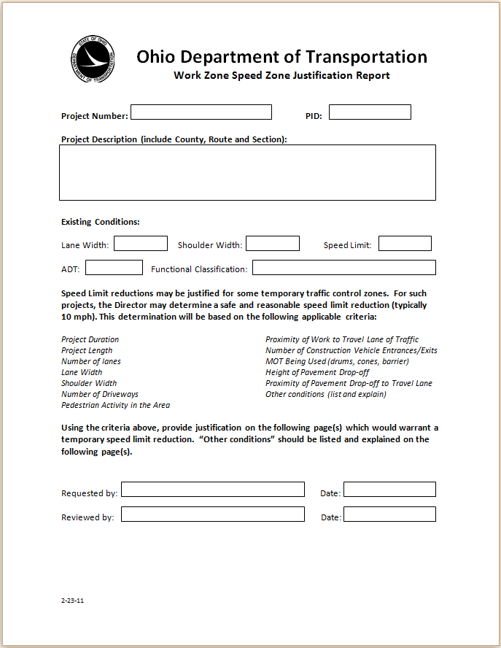
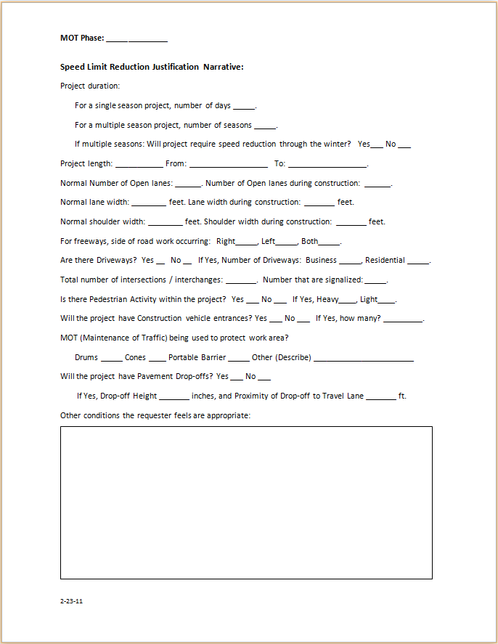
Proposed Work Zone Speed Zone Process: Form 1296-16–Work Zone Speed Zone Justification Report
Notes:
This is Form 1296-16, the draft Work Zone Speed Zone Justification Report. It collects and documents detail and information on the project so evaluations can be made.

Slide 19
Proposed Work Zone Speed Zone Process: For ODOT Operations/Maintenance Work
For ODOT Operations/Maintenance Work the process is similar to initiating a request for construction projects during construction, but once again has some differences.
The big differences are:
One additional criteria for application of the process is if the work is projected to take more than 3 hrs. This was suggested to attempt to find a balance between the additional exposure created by installing and removing the signs in relation to the time needed to complete the work.
The people involved in the process change slightly. (The PE is now the County Manager and the DWZTM is not involved. The DSZC remains involved and provides the consistency in the application of work zone speed zones.)
Notes:
FOR ODOT OPERATIONS/MAINTENANCE WORK…
Very similar to during construction, with a few changes.
There is an additional criteria added for application of the process. If the project is not projected to take 3 hrs it is suggested that a reduction not be put into place. This was in an attempt to find a balance between the additional exposure created by installing and removing the signs in relation to the time needed to complete the work.
Once again the people involved in the process changed slightly. The project engineer is now the county manager and the DWZTM is no longer involved. The DSZC still remains the last point before approval and is intended to provide the consistency in the application of work zone speed zones.

Slide 20
Maintenance/Force Account Work
High-Speed Multi-Lane Highway
(55 mph or greater)?
NO
CM submits Form 1296-16 (Justification Form) to DSZC
No reductions should be put into place.
YES
DSZC references Table 1297-7.
Work more than 3 hours?
NO
YES
Did Form 1297-17 warrant a reduced speed limit?
YES
Does Table 1297-7 suggest use of Form 1297-17 (Excel)?
NO
NO
If approved, DSZC prepares Speed Limit Revision Form and returns a copy to the Designer and OTE. CM incorporates speed limit reduction into project.
Speed limit reduction is not warranted based on conditions identified at this time.

Slide 21
Example Result
5 mile long paving project on a high-speed multi-lane highway
3-4 access points
less than 4k per lane (rural area)
11' or 12' maintained lane width
Drums less than 3' from the open lane of travel.
ANS: This would warrant a 10-mph reduction

Slide 22
Items to be Addressed in the Future
Other Multi-Lane Highways
Two-Lane Highways
Work Zone Increased Fine Sign Application
Notes:
I talked about this some earlier, but currently we don’t feel that the existing evaluation form that has been developed appropriately addresses the multi-lane highways that are under 55 mph. The characteristics are enough different that we feel that another form has to be developed for those facilities.
Along the same lines, two-lane highways would also need a different form as the characteristics of these are different as well. There is also some uncertainty about the appropriateness of speed limit reductions on two-lane highways. Some feel that traffic is supposed to be slowing or stopping for a flagger already.
The increased fine sign application may need revised in the OAC if we intend to use it more than currently specified.
We hope this has at least given you an idea of where we are going with work zone speed zones…

Slide 23
Questions, Comments, Feedback?
Contact:
Juanita Elliott
Office of Traffic Engineering
614-644-8143
juanita.elliott@dot.state.oh.us
or
Emily Willis
Office of Traffic Engineering
614-644-8179
emily.willis@dot.state.oh.us

Slide 24
Thank You
Dave Holstein, Administrator
Office of Traffic Engineering
614-644-8137
dave.holstein@dot.state.oh.us
Reynaldo Stargell
Office of Traffic Engineering
614-644-8177
reynaldo.stargell@dot.state.oh.us

